Slide 1
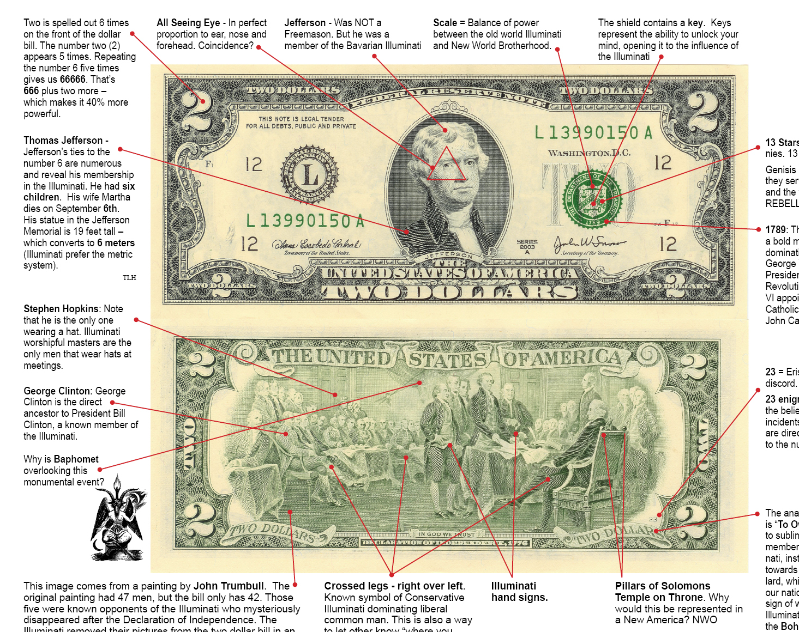
Cognitive Deviance
(unconventional beliefs)
Notes:
Image: two dollar bill analyzed for secret symbols

Slide 2
Beliefs risk being evaluated negatively when:
They represent a minority view in a given collective
Are associated with other negative traits or attitudes
Are expressed in a particular setting and to a particular audience

Slide 3
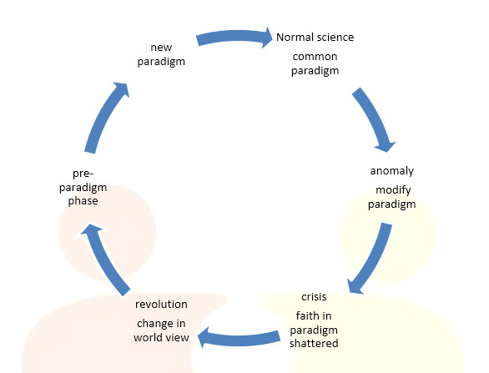

The Relativity of Cognitive Deviance:
From Unconventional to Conventional
Notes:
Images: Kuhn’s Cycle of Scientific Revolution and a person in scrubs washing their hands

Slide 4

The Contextuality of Cognitive Deviance: setting and audience

Slide 5
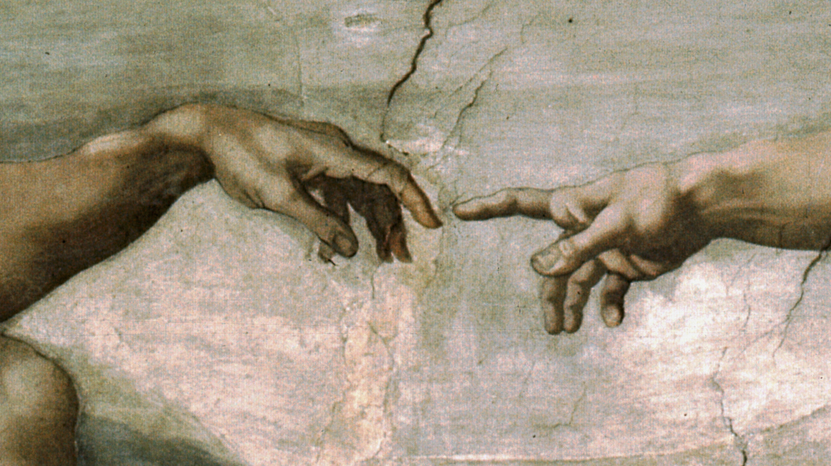
Creationism, Intelligent Design, and Scientific Evolution
(as an example of consensus and mutual deviantization in beliefs)
Notes:
Image: The Creation of Adam by Michelangelo

Slide 6

Institutionalizing Belief
Notes:
Supreme Court

Slide 7
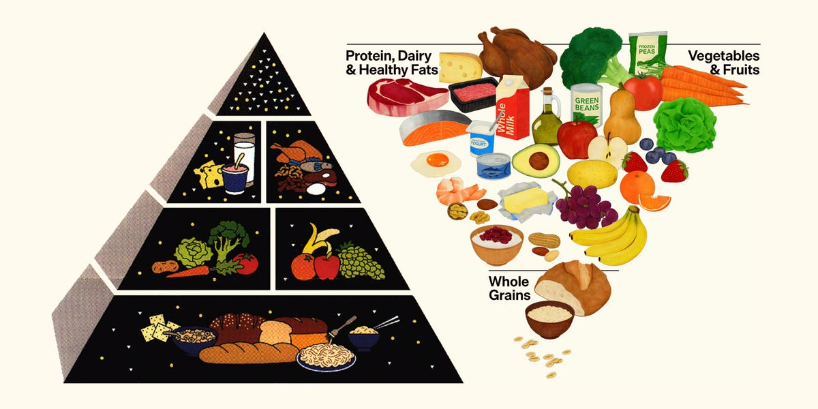
Notes:
Left hand image 1990 food pyramid, right hand 2026 food pyramid

Slide 8
Why the concern about deviant beliefs?
Connection to mental health concerns
The strong association that beliefs drive behavior
Association of deviant beliefs with “outsiders”
Concern about dissemination and influence

Slide 9
The Relationship Between Social Conditions and Belief Systems
The material world: includes things like money, technology, resources, natural environments
The ideational world: includes things like values, thoughts, beliefs, symbols
Material/economic determinism: the material world directs the ideational world
Elective affinity: the material world and the ideational world complement and strengthen one another

Slide 10
Paranormal Beliefs: explanations for phenomena found in popular culture, lore, or non-scientific bodies of knowledge that are generally outside of observable human experience or counter current scientific explanation
How are deviant beliefs advanced?
  By individuals (i.e., “the crank”)
  Within religious traditions (i.e., faith healers)
  Through client-practitioner relationships (i.e., psychics)
  Through parapsychology researchers (i.e., ghost hunters)
  Through grass roots collective of believers (i.e., alien abductees)

Slide 11

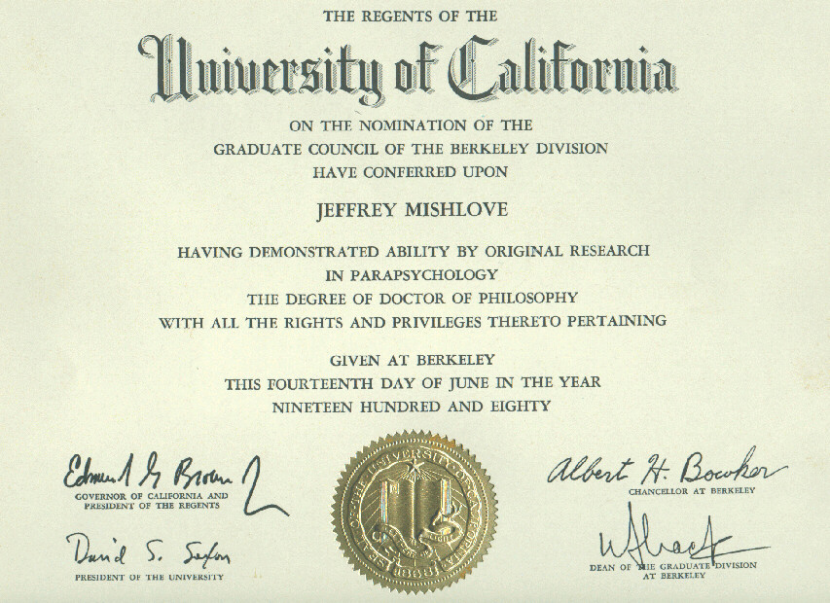
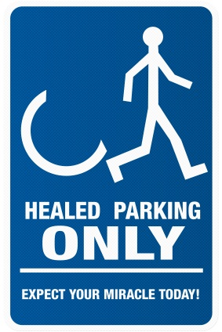
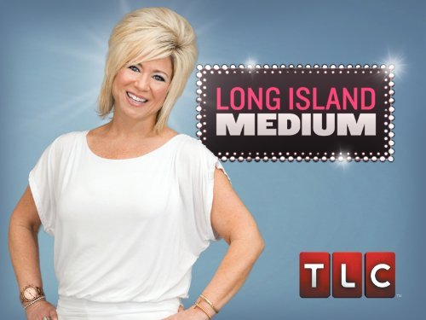
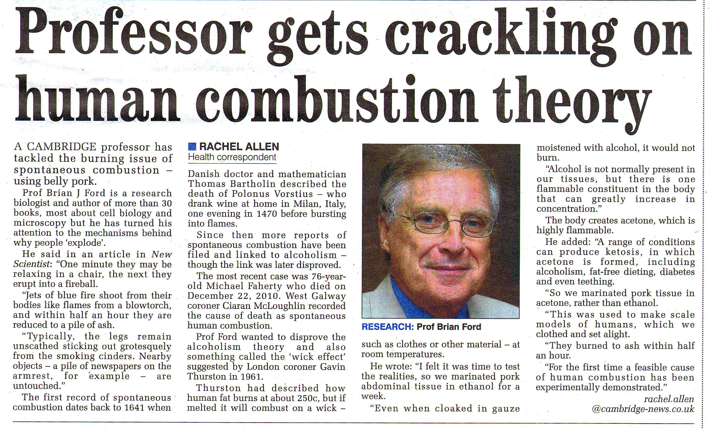
Notes:
Images starting far left, clockwise: Three “aliens”, sign designed as a parking placard for people who have been healed, Doctorate certificate in parapsychology, article on human combustion, ad for the TV show “Long Island Medium”

Slide 12
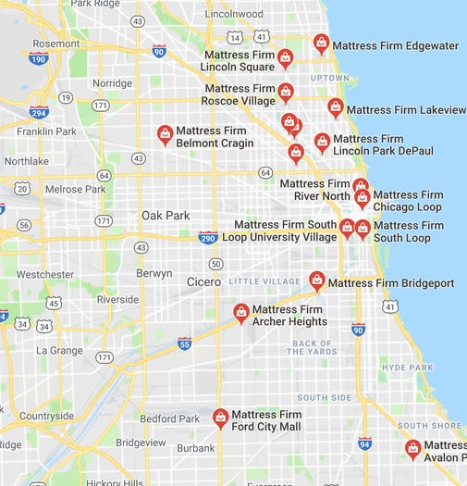
Conspiracy Theory: a belief that powerful groups/organizations are acting in secret to cause events against the interests of the public. The belief is advanced despite the implausibility of the claim or even when evidence disputes it
Characteristics:
Interesting narrative
Treacherous goals
Actions hidden or under “cloak of legitimacy”
Highly resourced
Sense of urgency
Evidence loop
Notes:
Image: map showing Mattress Firm locations in Chicago

Slide 13
Biases and Belief in the Paranormal and Conspiracy Theories
Intuition Bias
Big Events Bias
Confirmation Bias
In Group Bias

Slide 14
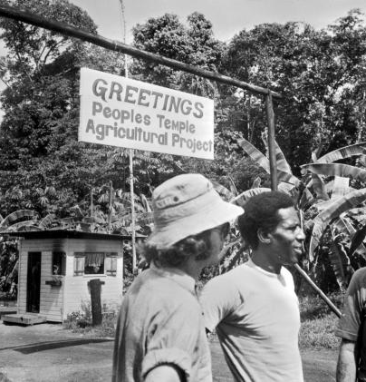
Newly Emerging Religions/New Religious Movements
(“Cults”)
Typical Interest Groups that Inform the Public about NERs:
The “anti-cult” movement
The media
NERs themselves
Academics
Notes:
Image: Two members of the People’s Temple outside signage at Jonestown

Slide 15
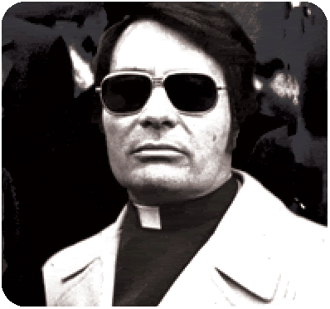
Groups that risk being labeled a “cult”:
Groups that appear to break with or diverge from traditional religious practice or doctrine
Groups that have a charismatic leader, strict hierarchy, and “encapsulated” leadership
Groups that demand a high level of commitment and loyalty from members
Groups that purport that their doctrine provides the singular pathway to answer all major life questions
Groups that require members to isolate from non-members, other social organizations, and stress privacy from outside scrutiny
Notes:
Image: Jim Jones

Slide 16
Who Joins?
Existing interpersonal bonds with members
During transitional times/experiences
Social grievances
Initial positive rewards
Models of Recruitment:
Deliberative model: people join because they agree with beliefs/goals of the group
Psychodynamic model: people join because the group satisfies (potentially unrecognized) psychological or emotional needs
Thought reform model: people join because they are manipulated or unduly influenced

Slide 17
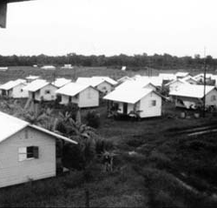
Social Control within NRMs
Behavioral Controls
Informational Controls
Thought Controls
Emotional Controls
Notes:
Image: Housing units at Jonestown

